Slide 1
Spring Boot - Cloud Configuration Server
Spring Cloud Configuration Server is a centralized application that manages all the application related configuration properties
Micro Service Application 1
Register
Micro Service Application 3
Register
Cloud Configuration Server
Register
Micro Service Application 2

Slide 2
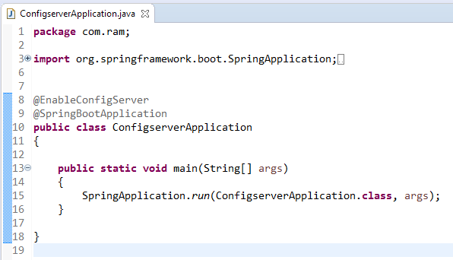
Spring Boot - Cloud Configuration Server
@EnableConfigServer annotation makes your Spring Boot application act as a Configuration Server.

Slide 3

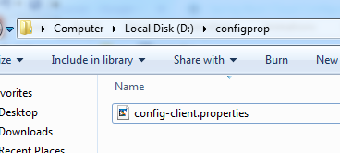
Spring Boot - Cloud Configuration Server
Configuration Server runs on the Tomcat port 8888 and application configuration properties are loaded from native search locations.
Now, in file:///D:/configprop/, place your client application - application.properties file. For example, your client application name is config-client, then rename your application.properties file as config-client.properties and place the properties file on the path file:///D:/configprop/.

Slide 4
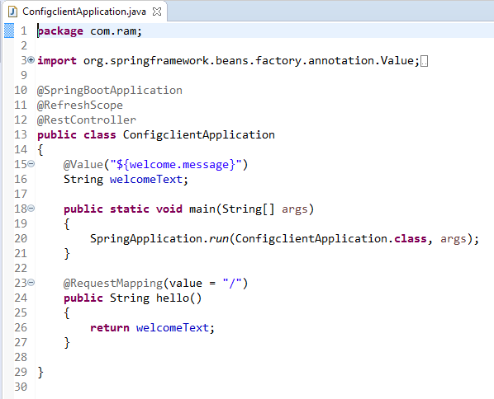

Spring Boot - Cloud Configuration Client
Some applications may need configuration properties that may need a change and developers may need to take them down or restart the application to perform this. However, this might be lead to downtime in production and the need of restarting the application. Spring Cloud Configuration Server lets developers to load the new configuration properties without restarting the application and without any downtime
The @RefreshScope annotation is used to load the configuration properties value from the Config server
http://localhost:8888 config server should be run before starting the config client application.

